Slide 1




COURSE ARTIFICIAL INTELLIGENCE AND DEEP LEARNING (AIDL)
UNIT-V
Mr. P Ramu,Assistant Professor

Slide 2
UNIT – V
BASICS OF DEEP LEARNING
1. Deep learning architectures: Convolutional Neural Networks : Neurons in Human Vision
2. The Shortcomings of Feature Selection
3.Full Description of the Convolutional Layer
4. Max Pooling
5. Full Architectural Description of Convolution Networks
6. Closing the Loop on MNIST with Convolutional Networks
7.Building a Convolutional Network for CIFAR-10
8.Visualizing Learning in Convolutional Networks
9. Leveraging Convolutional Filters to Replicate Artistic Styles
10. Learning Convolutional Filters for Other Problem Domains
11. Training algorithms.

Slide 3
Introduction to Deep Learning
Deep Learning is a subfield of Machine Learning and a part of Artificial Intelligence that uses artificial neural networks with many layers to automatically learn patterns from large amounts of data.
It is inspired by the structure and functioning of the human brain, where interconnected neurons process information and learn from experience.

Slide 4
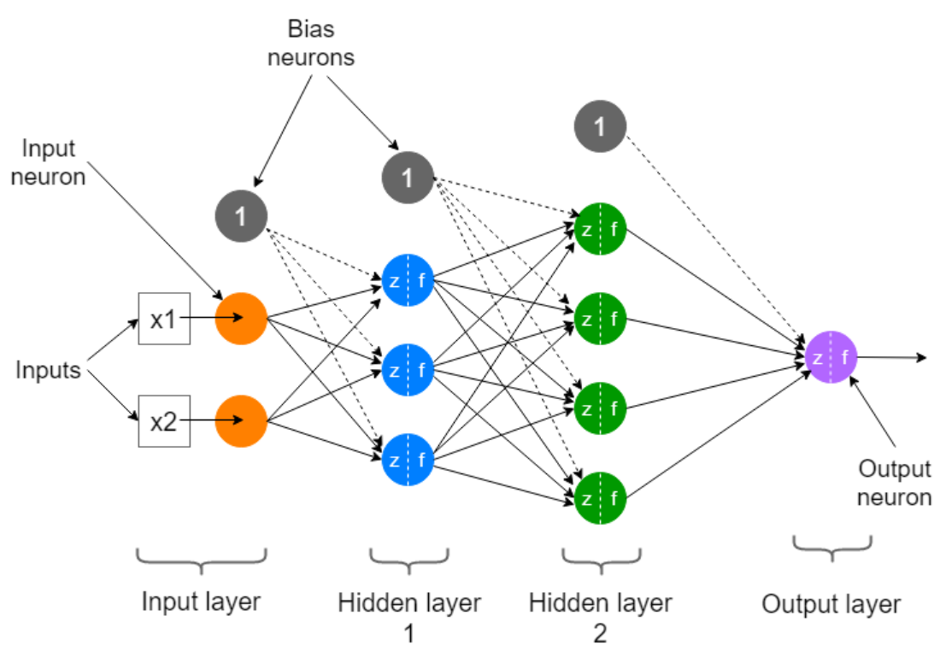
Deep learning architectures

Slide 5
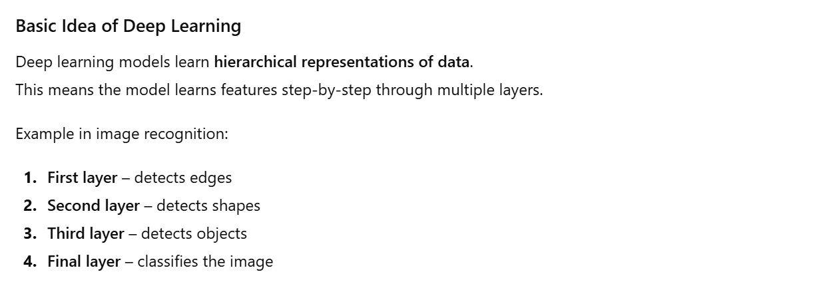

Slide 6
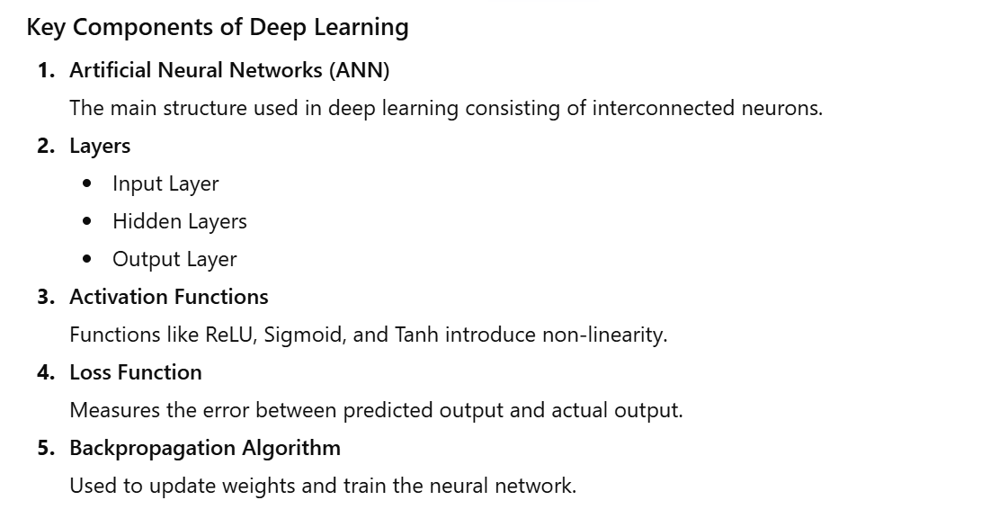

Slide 7
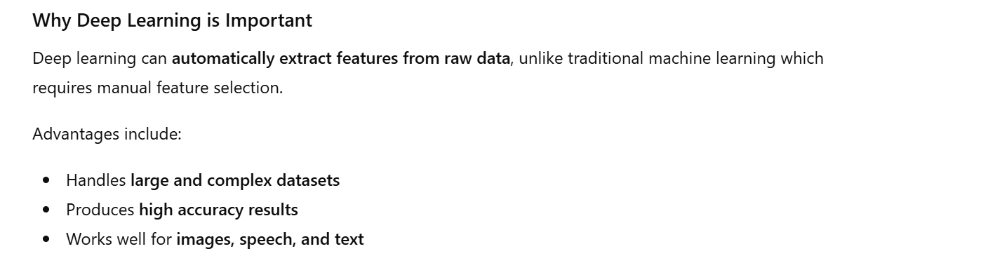

Slide 8
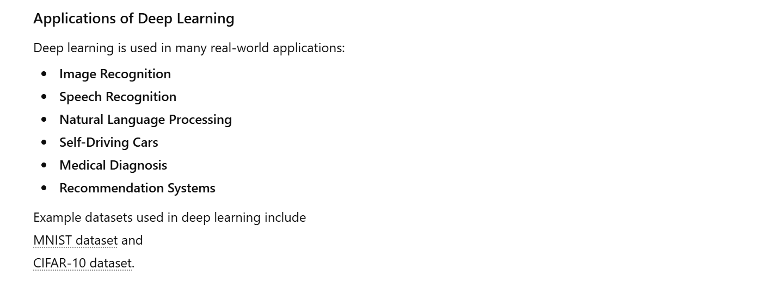

Slide 9
Types of Deep Learning
Artificial Neural Networks (ANN)
Convolutional Neural Networks (CNN)
Recurrent Neural Networks (RNN)
Long Short-Term Memory (LSTM)
Generative Adversarial Networks (GAN)

Slide 10
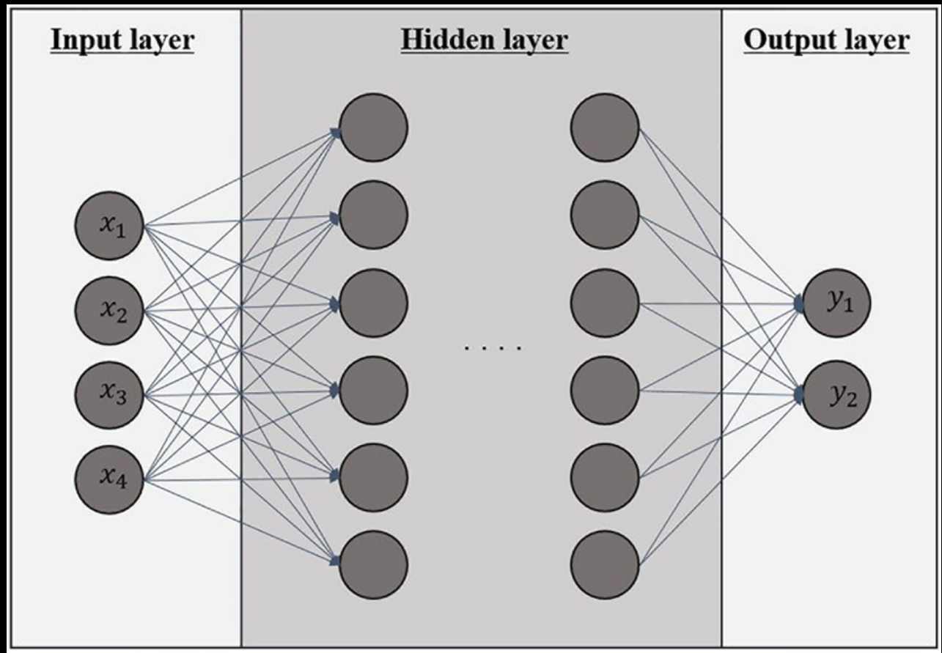
1. Artificial Neural Networks (ANN)
Artificial Neural Networks (ANN) are the basic model of deep learning.
Features
Consists of input, hidden, and output layers
Each neuron is connected with weighted links
Uses activation functions to produce output
Applications
Pattern recognition
Financial forecasting
Medical diagnosis
Classification problems

Slide 11
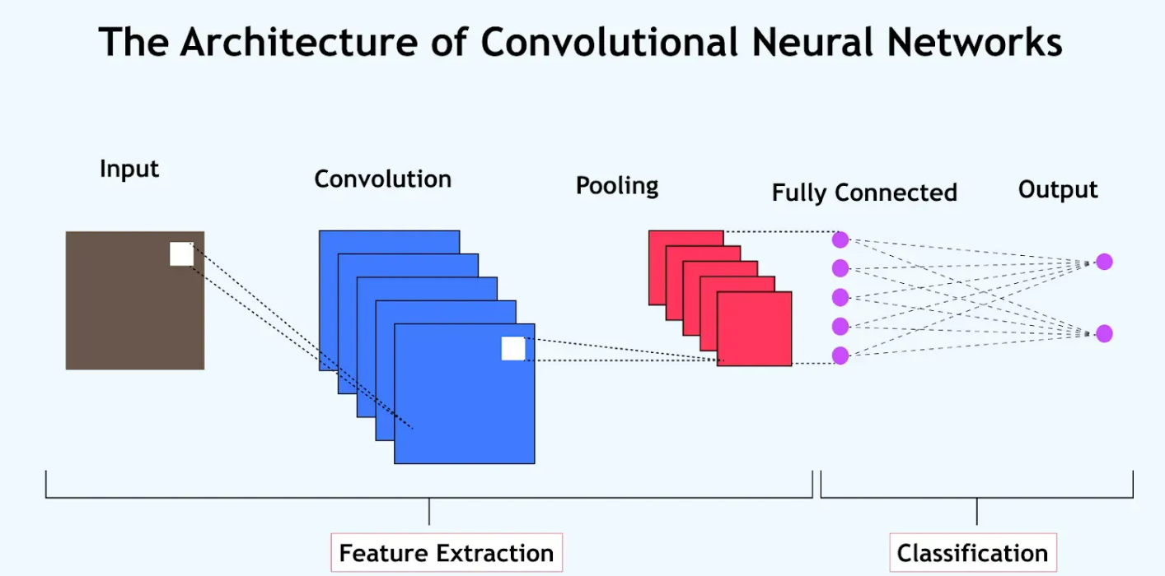
2. Convolutional Neural Networks (CNN)
Convolutional Neural Networks (CNNs) are mainly used for image and visual data processing in Deep Learning.
Features
Uses convolution filters to detect features
Extracts edges, shapes, and textures
Uses pooling layers to reduce feature map size
Applications
Image recognition
Face detection
Medical image analysis
Self-driving cars

Slide 12
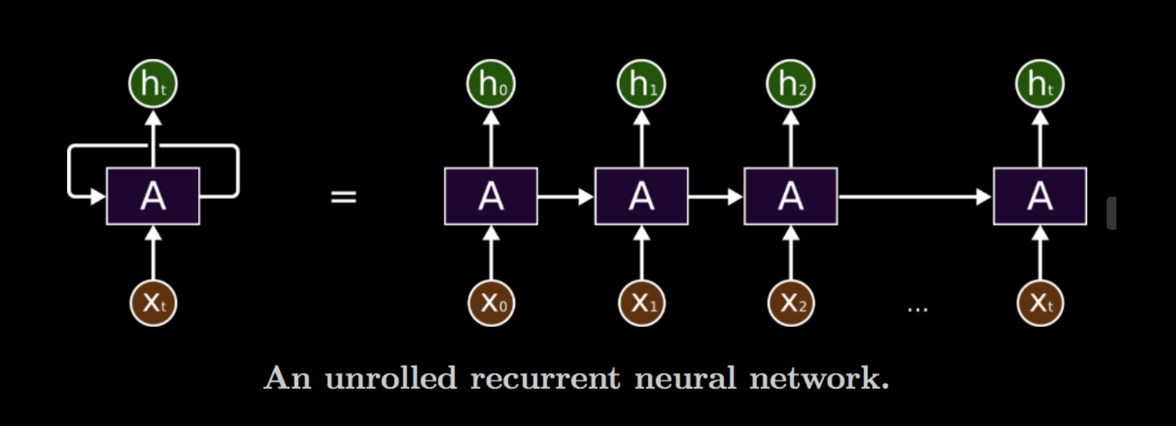
3. Recurrent Neural Networks (RNN)
R
Recurrent Neural Networks (RNNs) are designed to process sequential data.
Features
Uses feedback connections
Maintains memory of previous inputs
Suitable for time-dependent data
Applications
Speech recognition
Language translation
Text generation
Time-series prediction

Slide 13
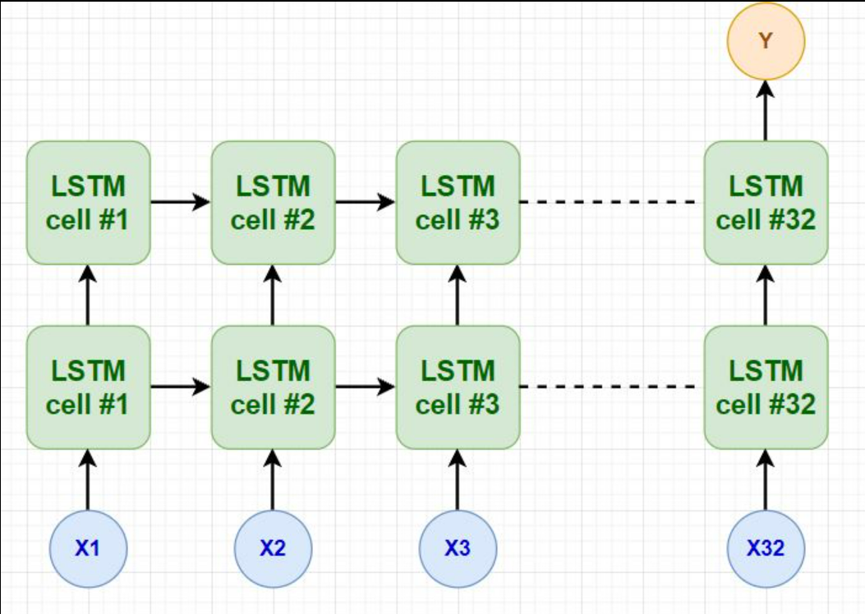
4. Long Short-Term Memory (LSTM)
Long Short-Term Memory (LSTM) is an advanced type of RNN that solves the long-term dependency problem.
Features
Uses memory cells
Contains three gates:
Input gate
Forget gate
Output gate
Applications
Machine translation
Speech recognition
Stock prediction
Text prediction

Slide 14
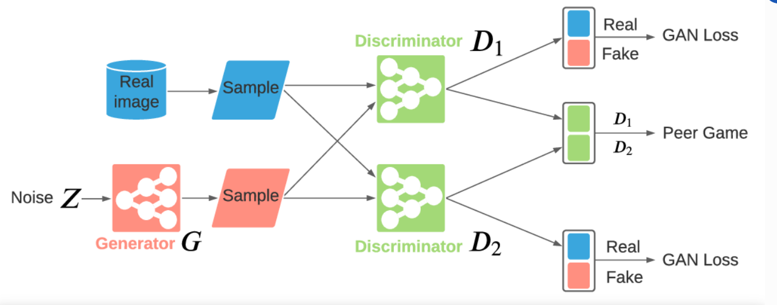
5. Generative Adversarial Networks (GAN)
Generative Adversarial Networks (GANs) are used to generate new data similar to training data.
Structure
Generator – creates fake data
Discriminator – distinguishes real data from fake data
Applications
Image generation
Deepfake videos
Image enhancement
AI-generated art

Slide 15
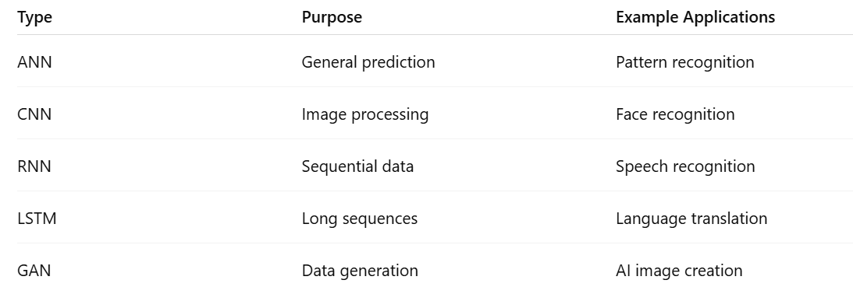
Summary Table

Slide 16
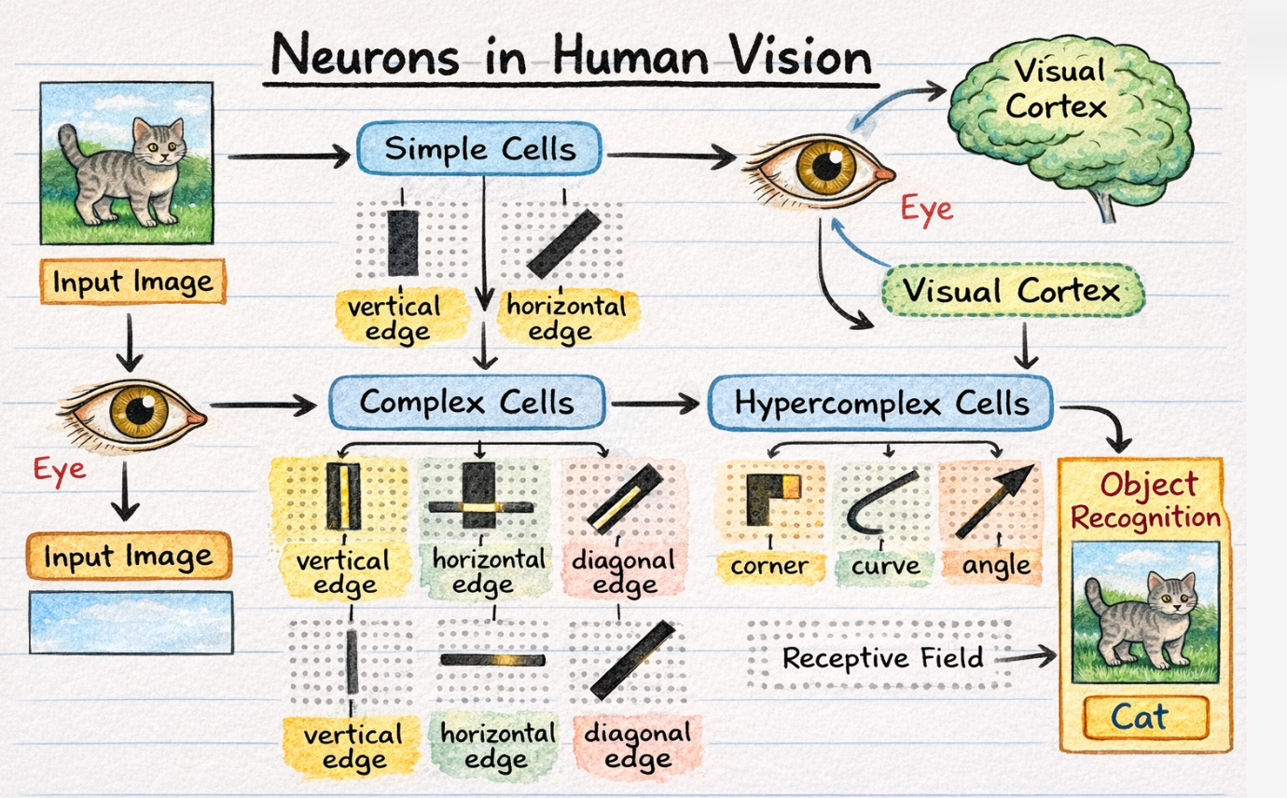
1. Convolutional Neural Networks: Neurons in Human Vision

Slide 17
Human Visual Processing System
In humans, vision is processed in the visual cortex:
Steps:
1.Eyes capture light and form an image
2.Signals are sent to the brain
3.Neurons detect features like edges, colors, motion
4.Brain combines features → object recognition

Slide 18
Types of Neurons in Human Vision
1. Simple Cells
Detect edges and orientations
Respond to specific patterns (horizontal, vertical, diagonal lines)
Example: activates only for a vertical edge
2. Complex Cells
Detect patterns irrespective of exact position
Respond to moving edges
Combine outputs from simple cells
3. Hypercomplex Cells
Detect complex shapes like corners, curves
Help in recognizing objects

Slide 19
Receptive Field
A receptive field is the region of the visual field a neuron responds to.
Each neuron sees only a small part of the image
Multiple neurons combine → full image understanding
In CNNs, this is similar to filters (kernels) scanning small regions.

Slide 20
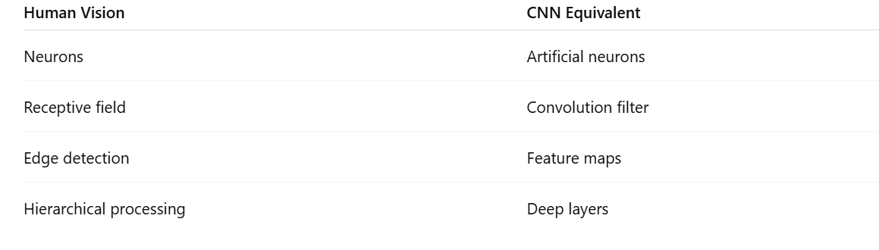
Mapping Human Vision to CNN

Slide 21
Hierarchical Feature Learning in CNN
CNN mimics human vision by learning features in stages:
First Layer → edges, lines
Second Layer → textures
Deeper Layers → shapes, objects
Final Layer → classification
Example: Human Vision
To recognize a cat:
Detect edges → ears
Detect shapes → face
Combine → identify as cat

Slide 22
2. The Shortcomings of Feature Selection
Feature Selection is the process of selecting the most relevant input variables (features) for building a model. While it is useful, it has several limitations, especially compared to modern approaches in Deep Learning like CNNs, which automatically learn features.

Slide 23
Major Shortcomings of Feature Selection
1. Manual Effort Required.
2. Loss of Important Information.
3. Not Scalable for Large Data.
4. Difficulty in Handling Complex Data.
5. Dependency on Data Representation.
6. Static Features (No Learning).
7. Limited Performance in Image Tasks.
8. Risk of Overfitting.

Slide 24
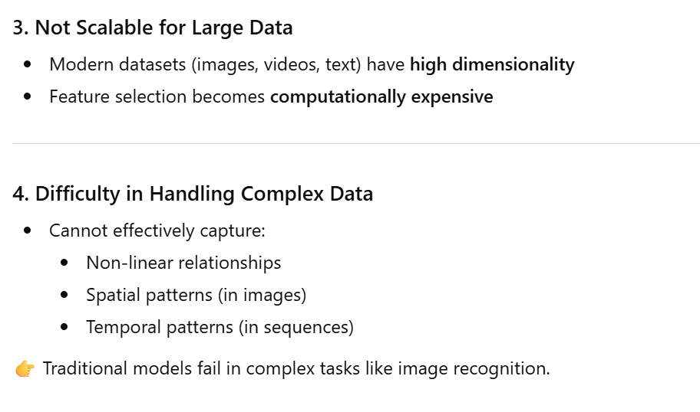
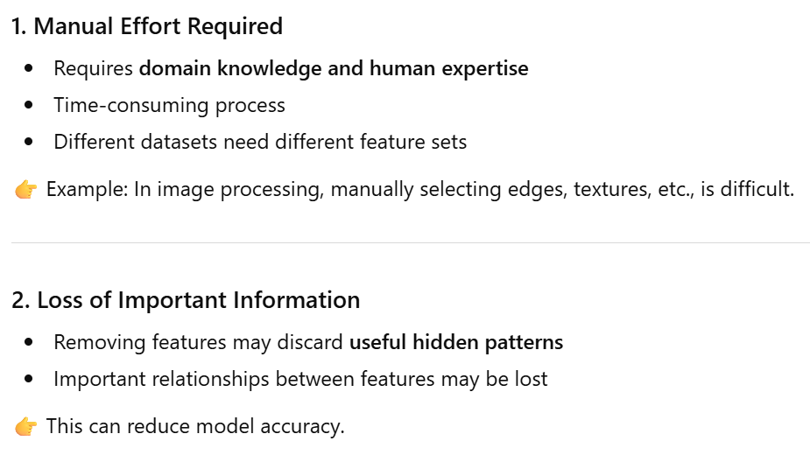

Slide 25
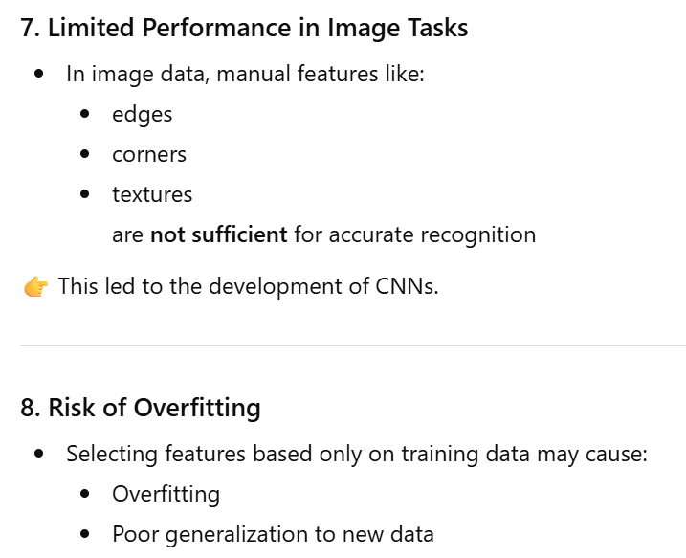
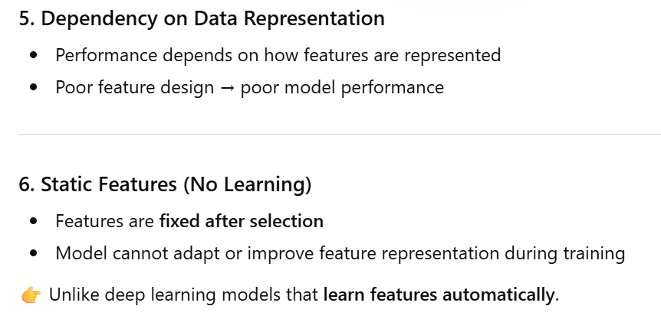

Slide 26
Why Deep Learning Overcomes These Issues
Modern models like CNNs in Deep Learning:
1. Automatically learn hierarchical features
2. Do not require manual feature selection
3. Handle complex data (images, videos) efficiently
4. Improve performance with large datasets

Slide 27
3. Full Description of the Convolutional Layer
Concept of Full Description of the Convolutional Layer
Introduction.
What is Convolution?
Components of Convolutional Layer.
Convolution Operation (Step-by-Step Example).
Output Size Formula.
Multiple Filters.
Activation Function.
Advantages.

Slide 28
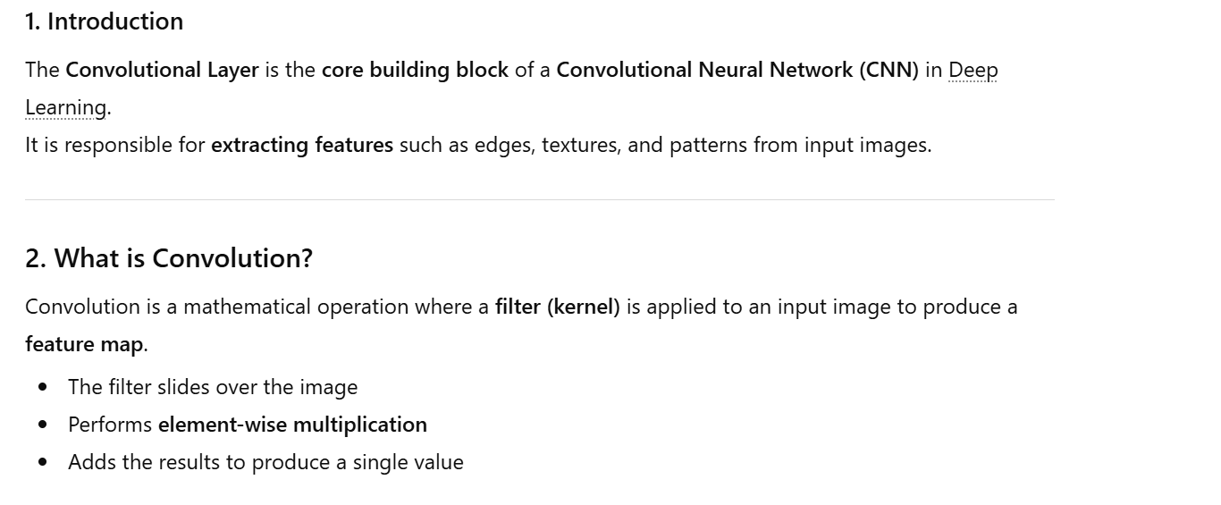

Slide 29
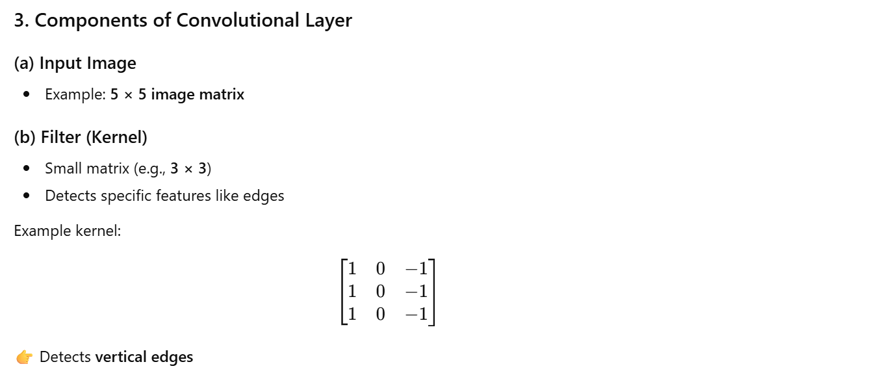

Slide 30
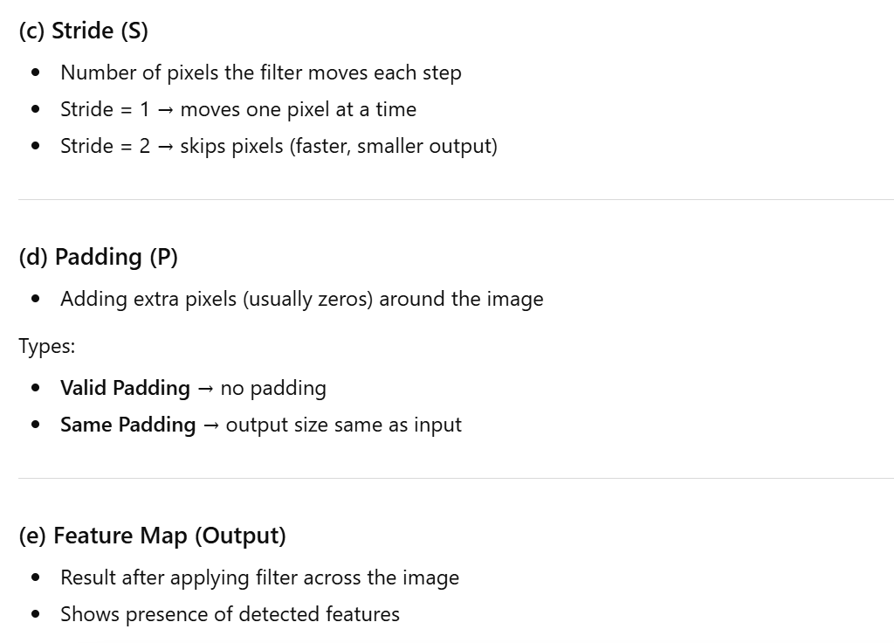

Slide 31
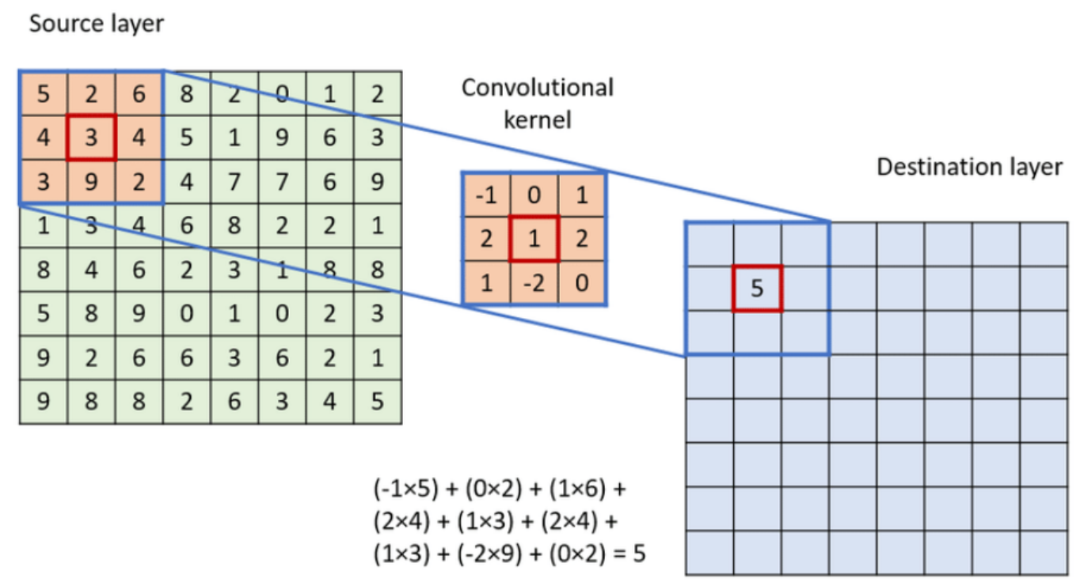
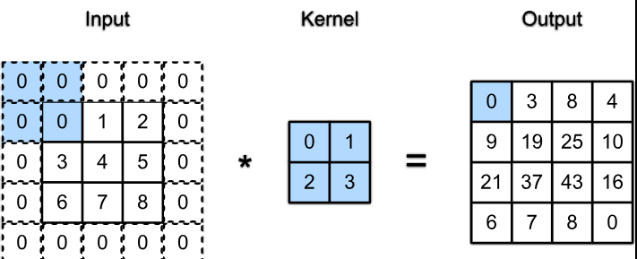

Slide 32
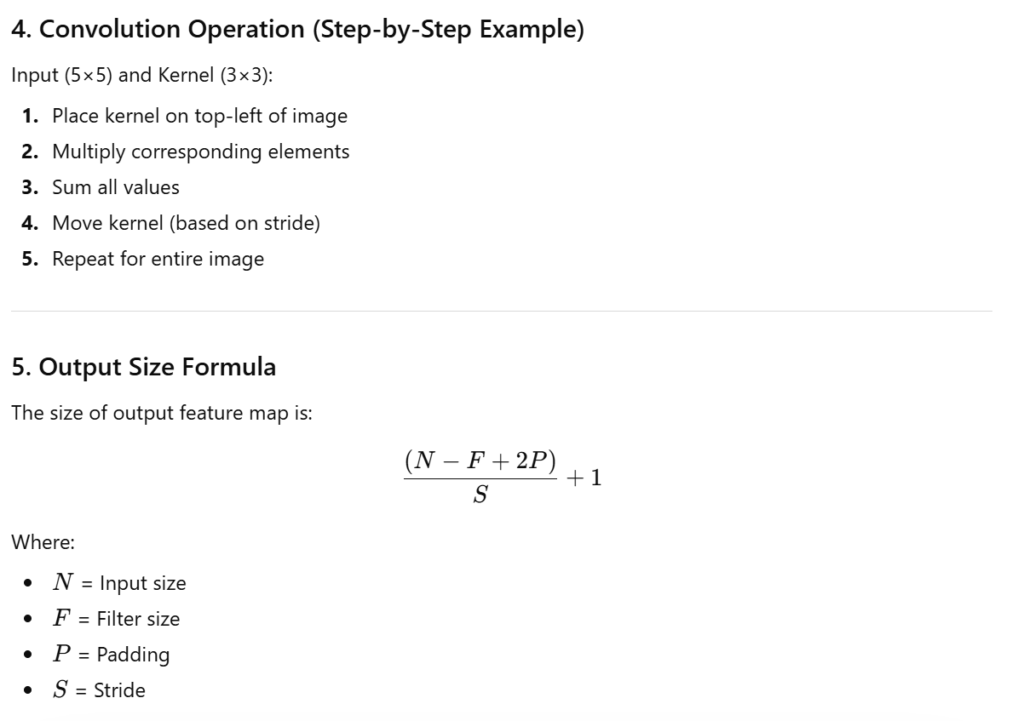

Slide 33
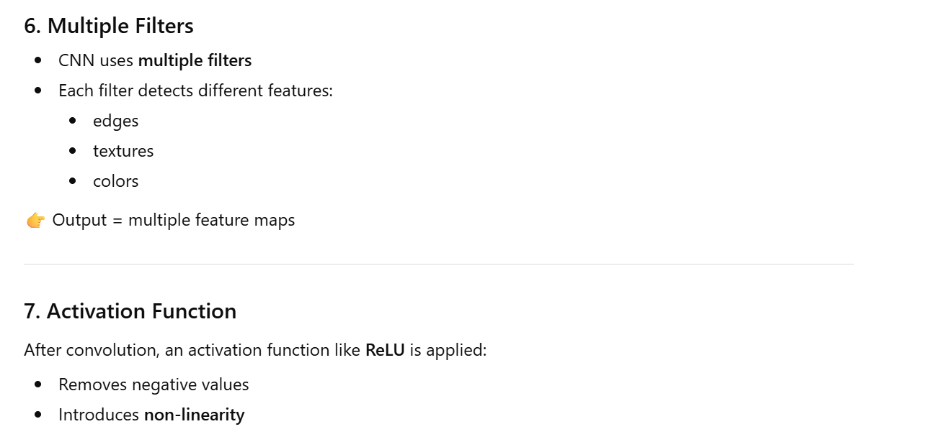
8. Advantages
Automatic feature extraction
Fewer parameters than fully connected layers
Efficient for image processing

Slide 34
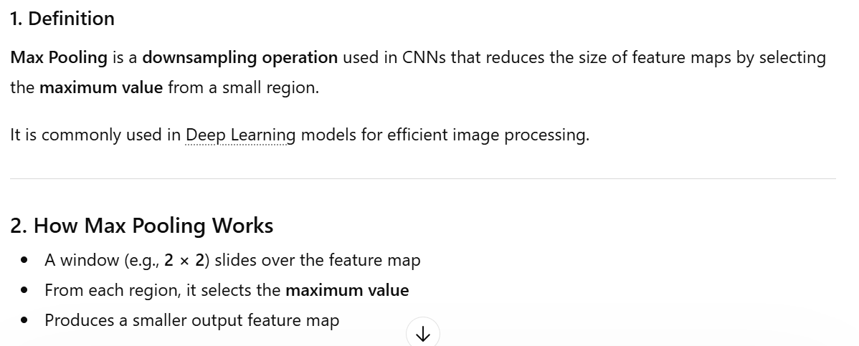
4. Max Pooling

Slide 35
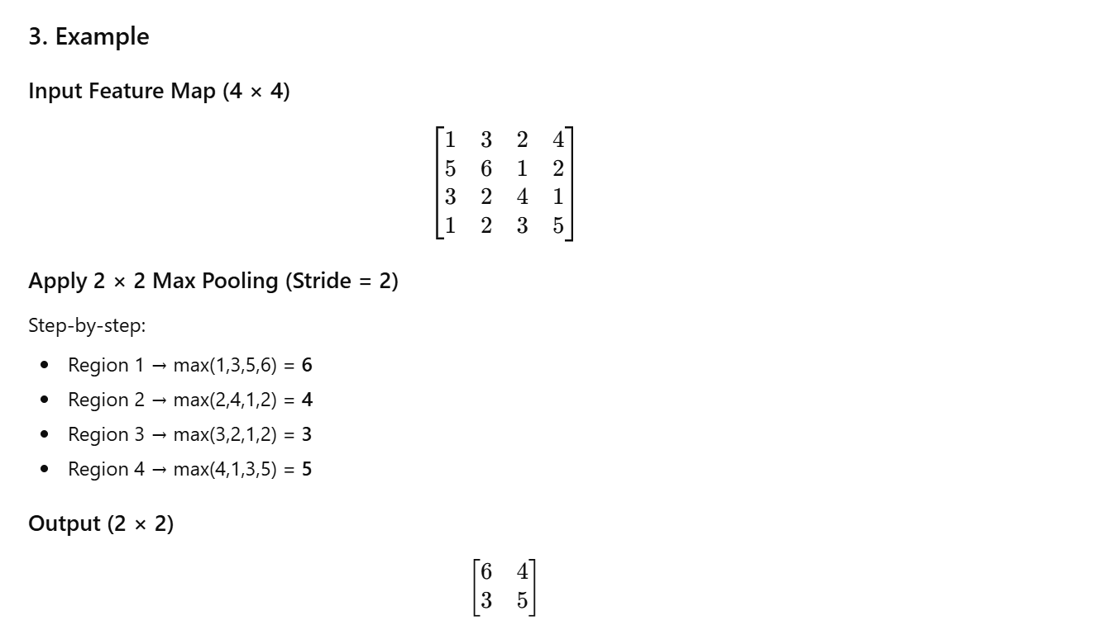

Slide 36
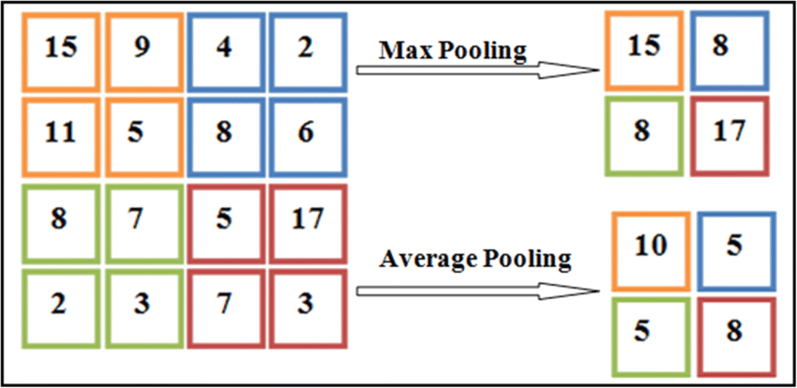

Slide 37
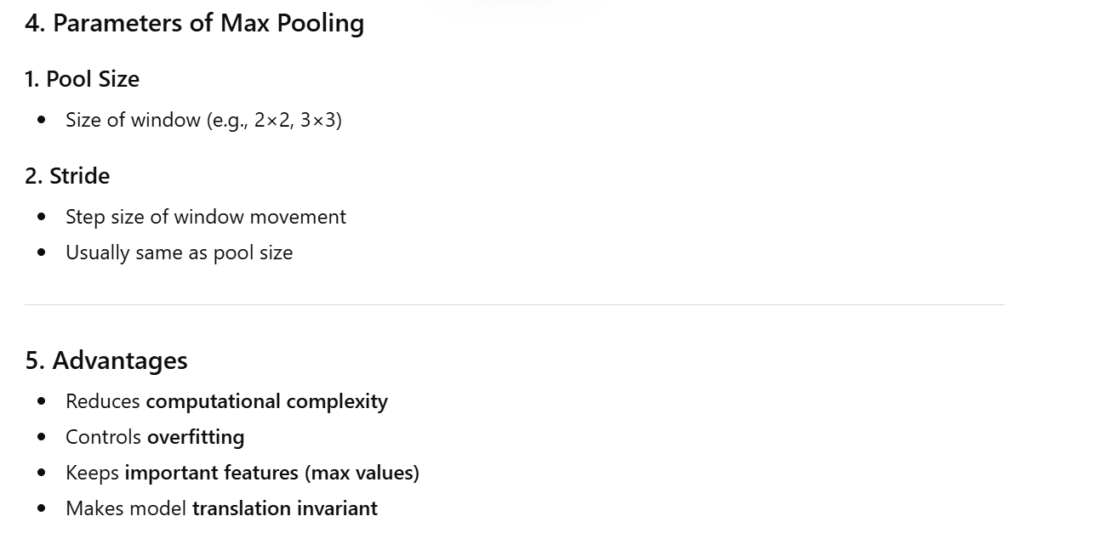

Slide 38
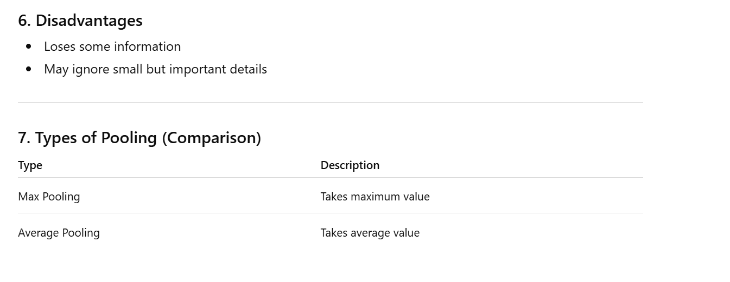

Slide 39
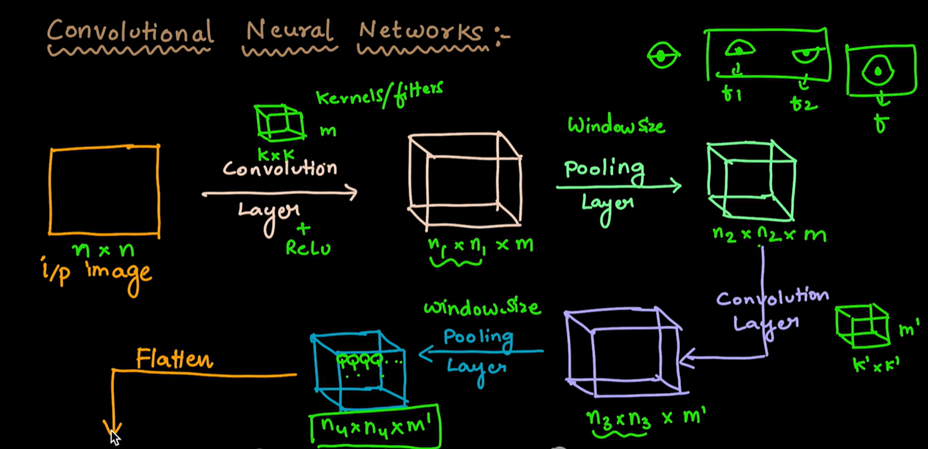
5. Architecture of Convolutional Neural Networks

Slide 40
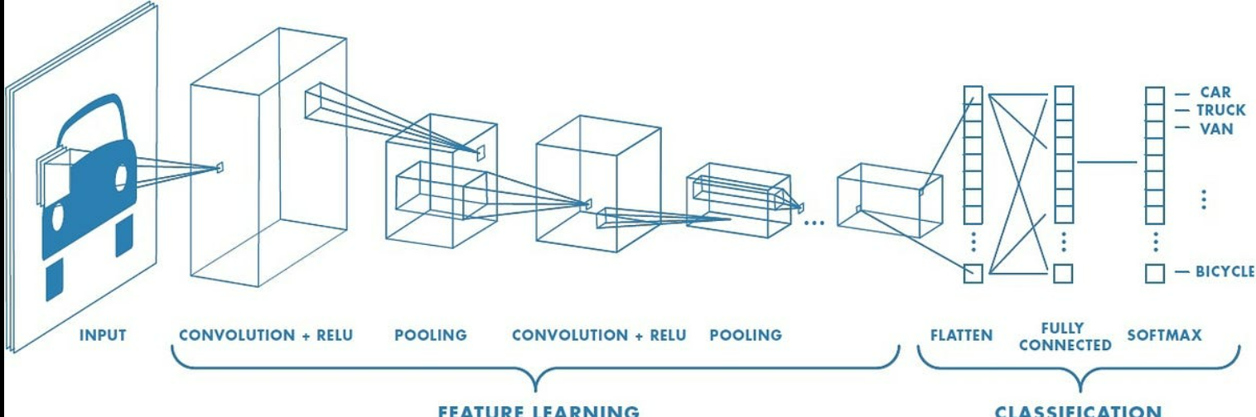
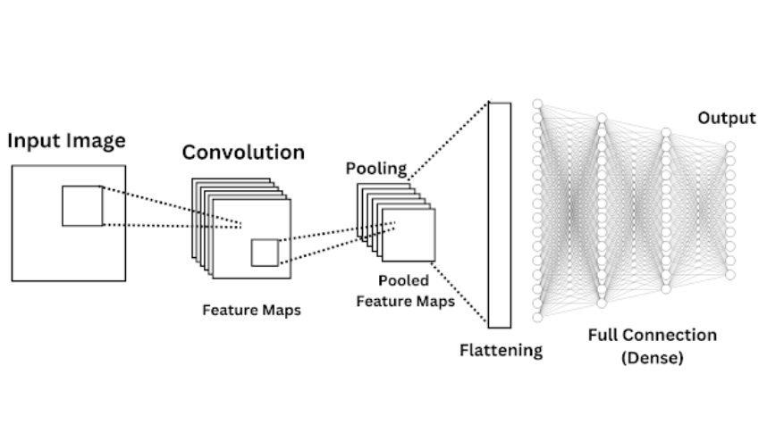
Architecture of Convolutional Neural Networks

Slide 41
Convolutional Neural Networks (CNN)
A Convolutional Neural Network (CNN) is a deep learning model used mainly for image recognition and computer vision tasks in Deep Learning.
CNN consists of several layers that work together to extract features and perform classification.

Slide 42
Main Layers of CNN
Input Layer.
2. Convolutional Layer.
3. Activation Layer.
4. Pooling Layer.
5. Flatten Layer.
6. Fully Connected Layer.
7. Output Layer.

Slide 43
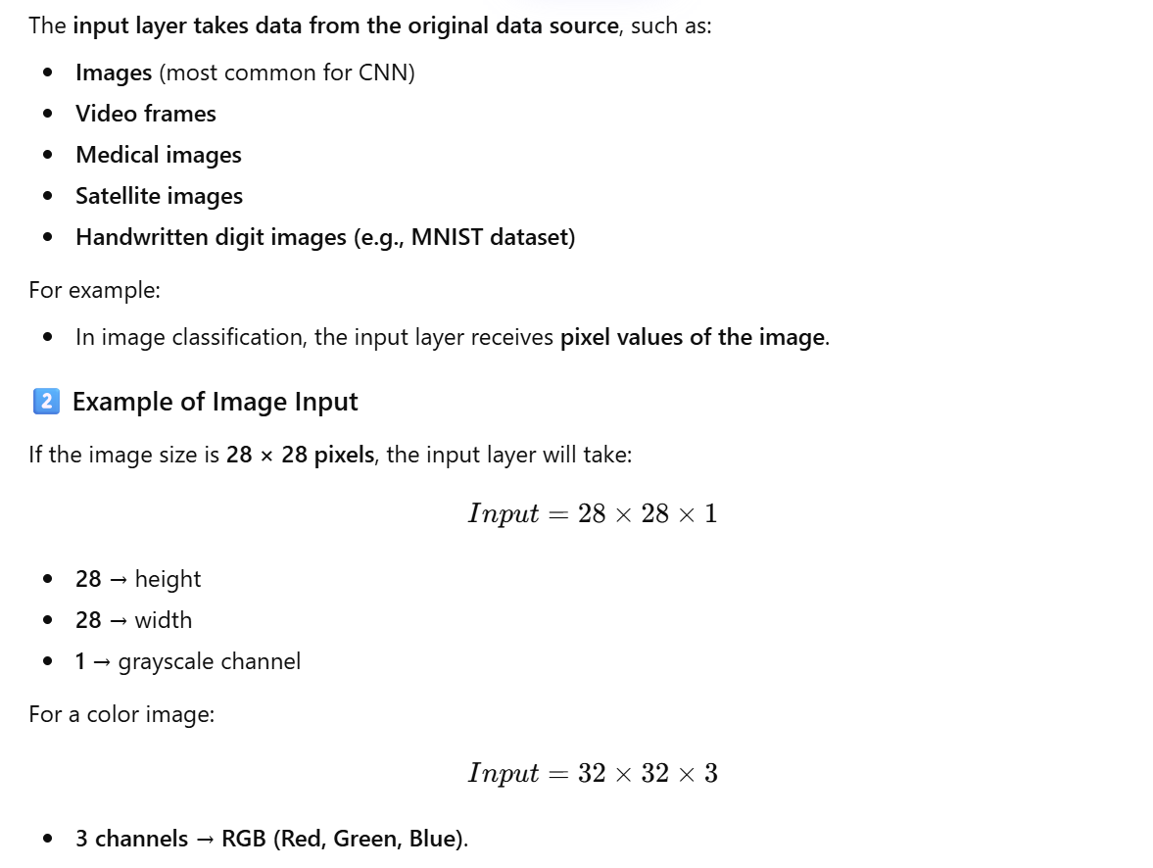
1. Input Layer

Slide 44
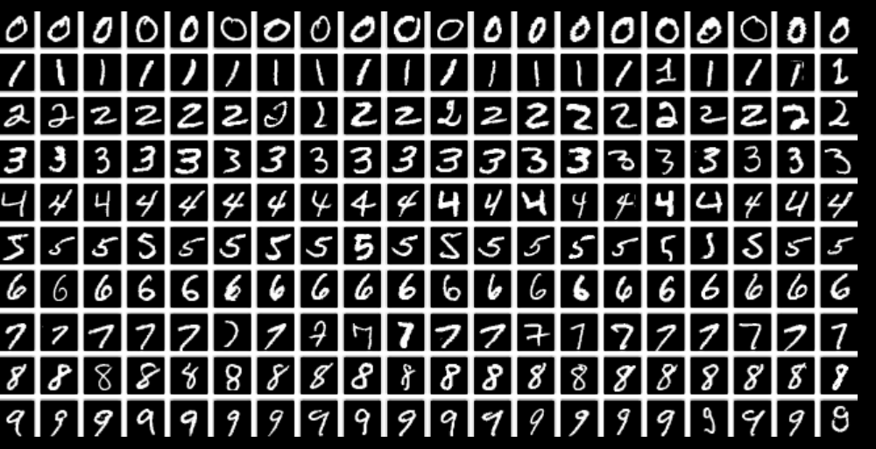
MNIST dataset in CNN
Characteristics:
Contains handwritten digit images (0–9)
Total images: 70,000
Training images: 60,000
Testing images: 10,000
Image size: 28 × 28 pixels
Grayscale images

Slide 45
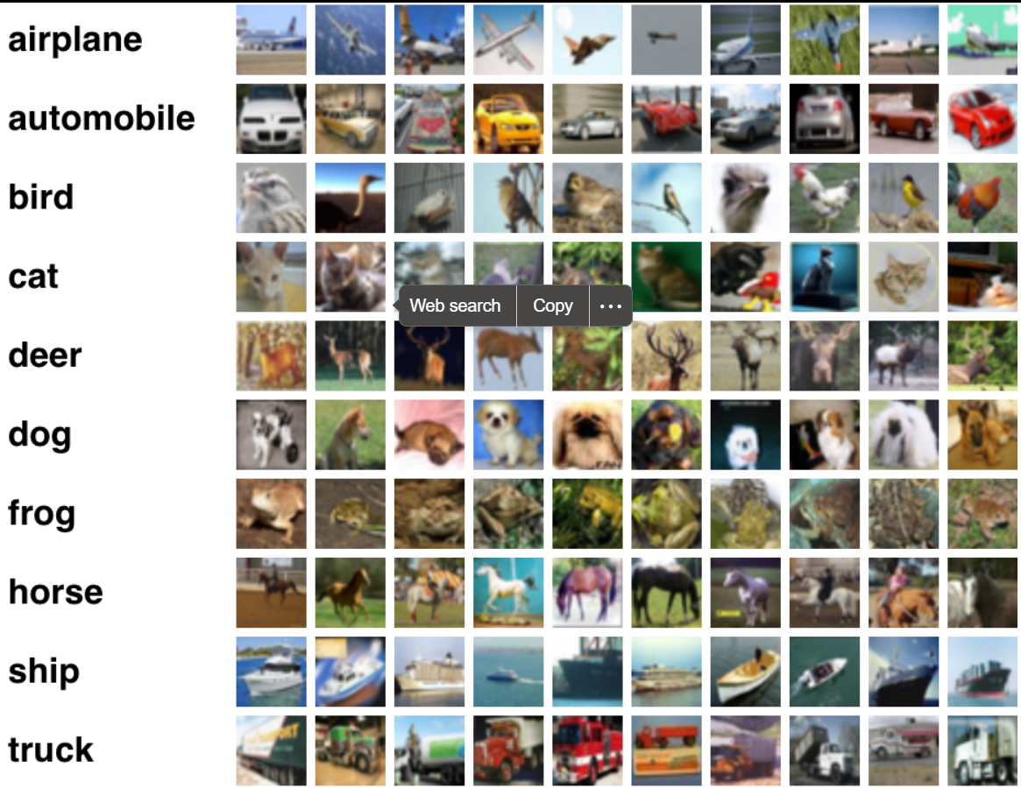
CIFAR-10 dataset in CNN
Characteristics:
Contains 60,000 color images
Image size: 32 × 32 pixels
Training images: 50,000
Testing images: 10,000
10 object categories

Slide 46
2. Convolutional Layer

Slide 47
2. Convolutional Layer

Slide 48
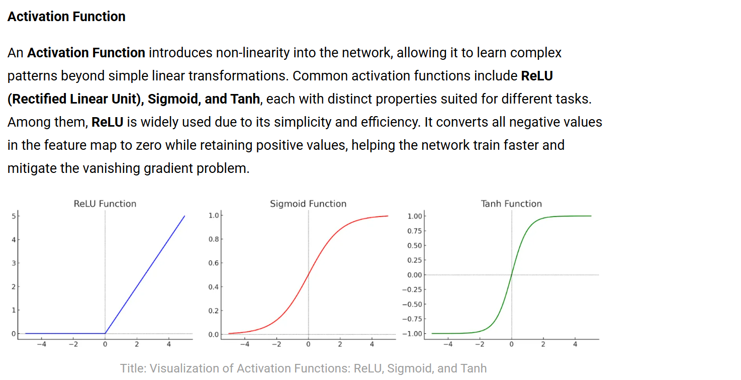
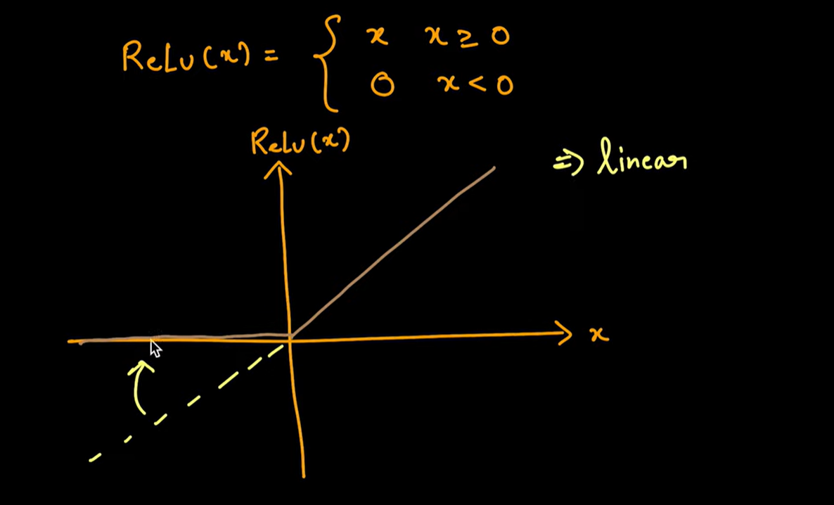
3. Activation Layer.

Slide 49
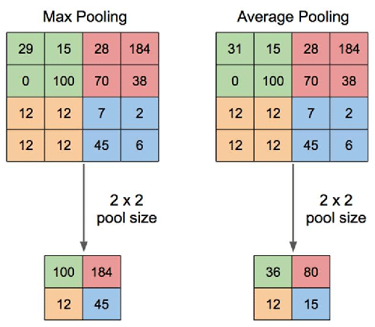
4. Pooling Layer

Slide 50
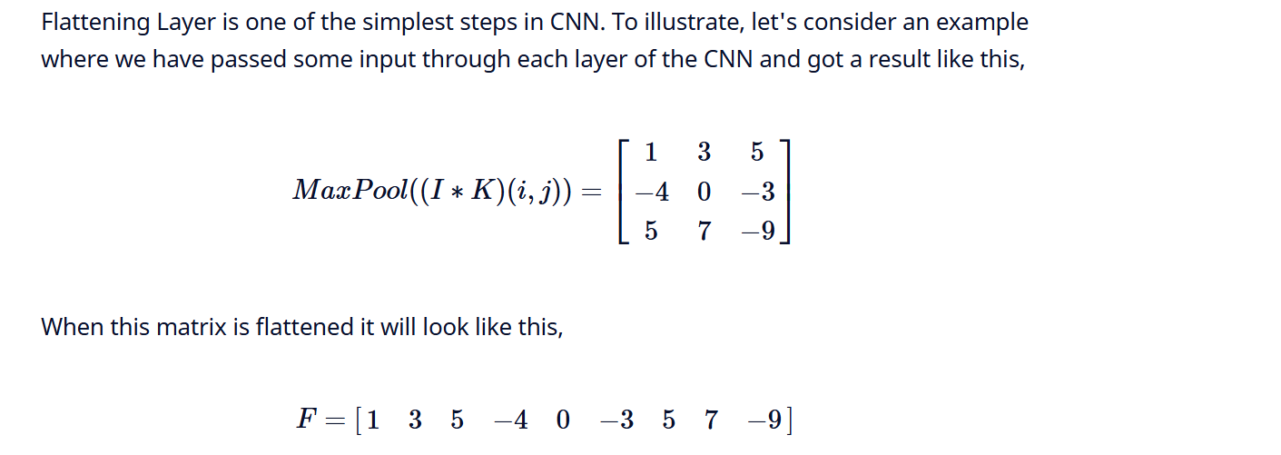
5. Flatten Layer

Slide 51
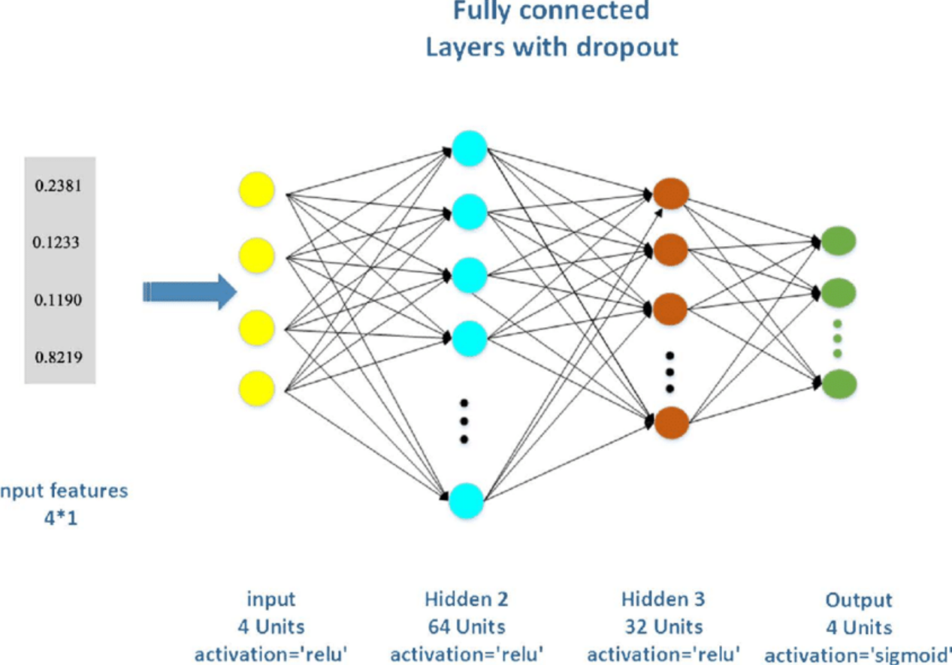
6. Fully Connected Layer

Slide 52
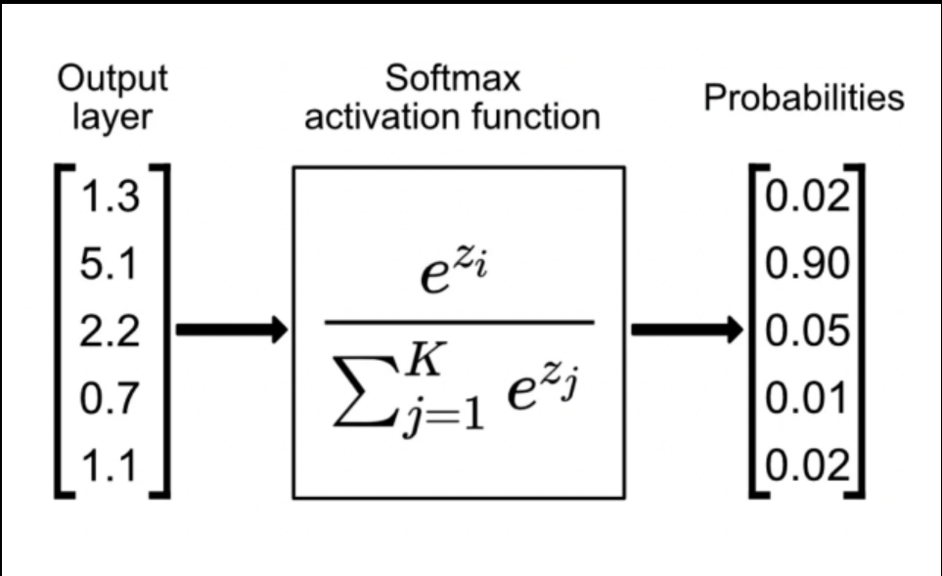
Softmax in CNN

Slide 53
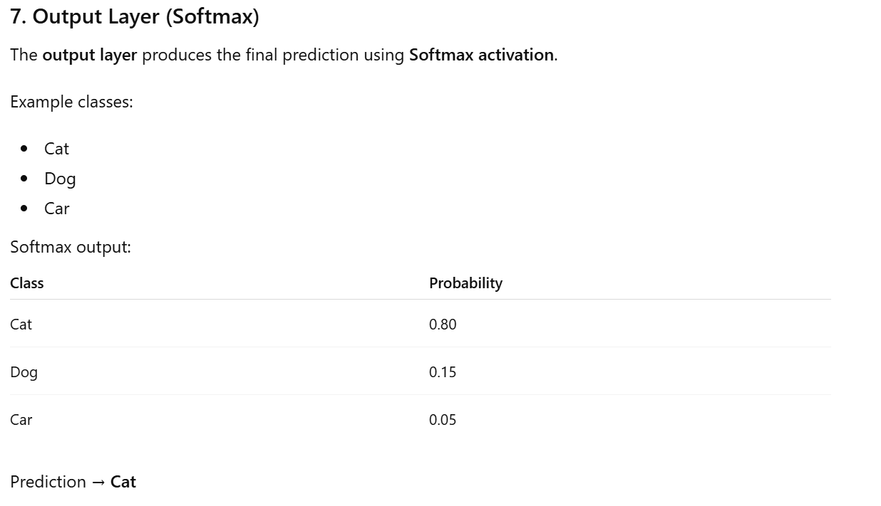
7. Output Layer

Slide 54
6. Closing the Loop on MNIST with Convolutional Networks
1. Introduction
“Closing the Loop on MNIST with Convolutional Networks” refers to using Convolutional Neural Networks (CNNs) to achieve high accuracy in handwritten digit recognition on the MNIST dataset.
It demonstrates how CNNs automatically learn features and outperform traditional machine learning methods in Deep Learning.

Slide 55
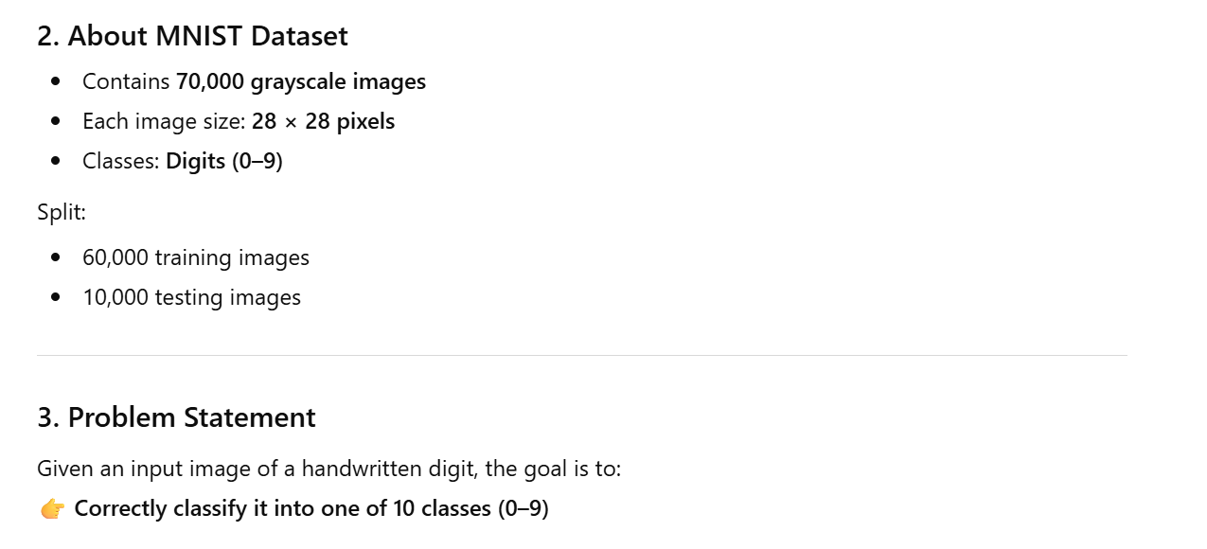

Slide 56
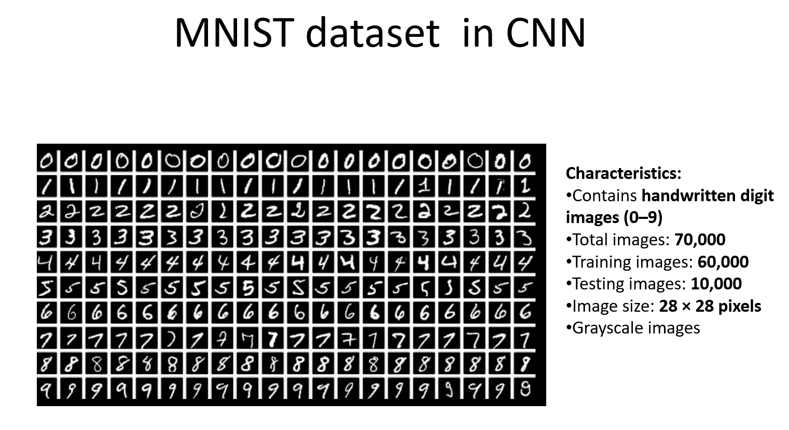

Slide 57
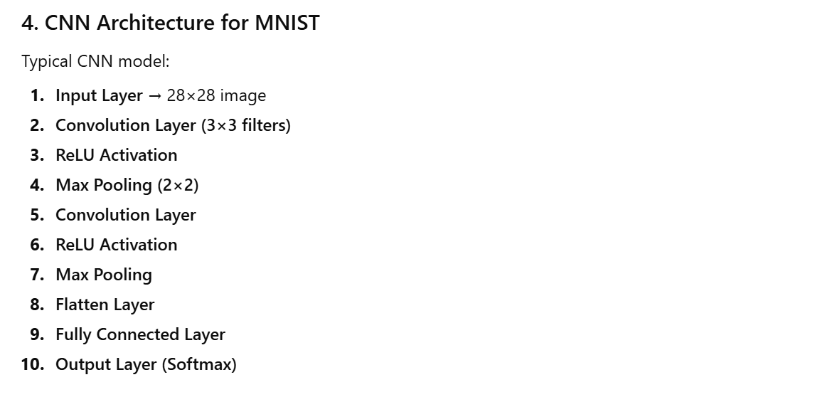

Slide 58
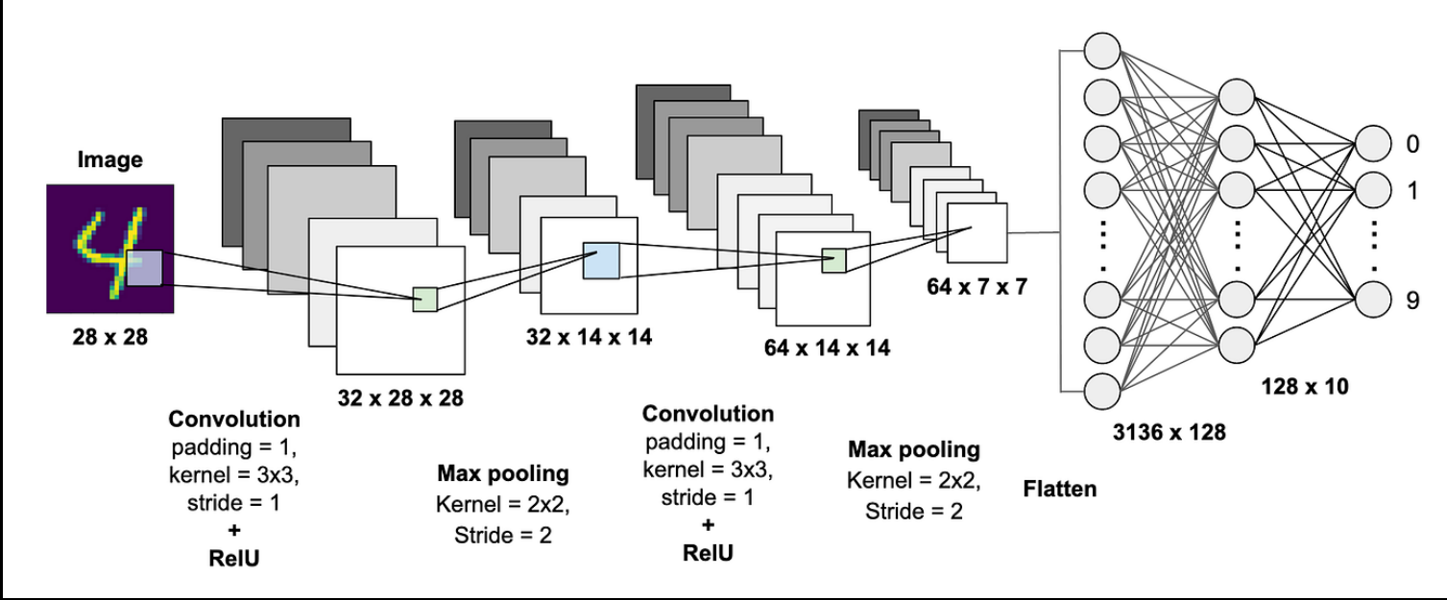
5. Working Process in MNIST

Slide 59
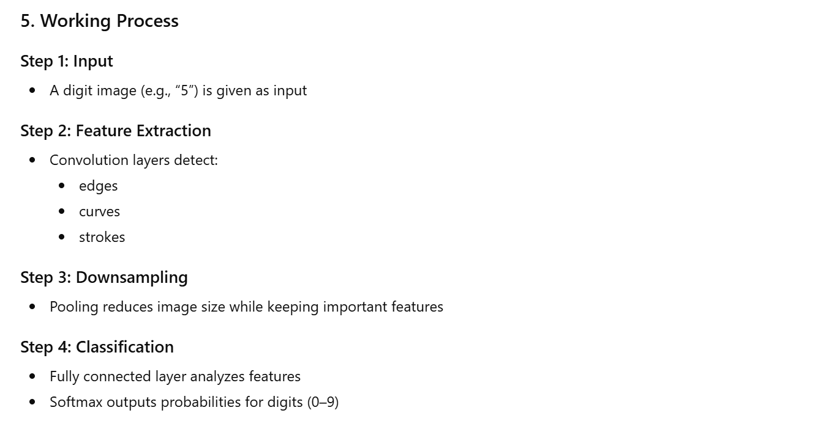

Slide 60
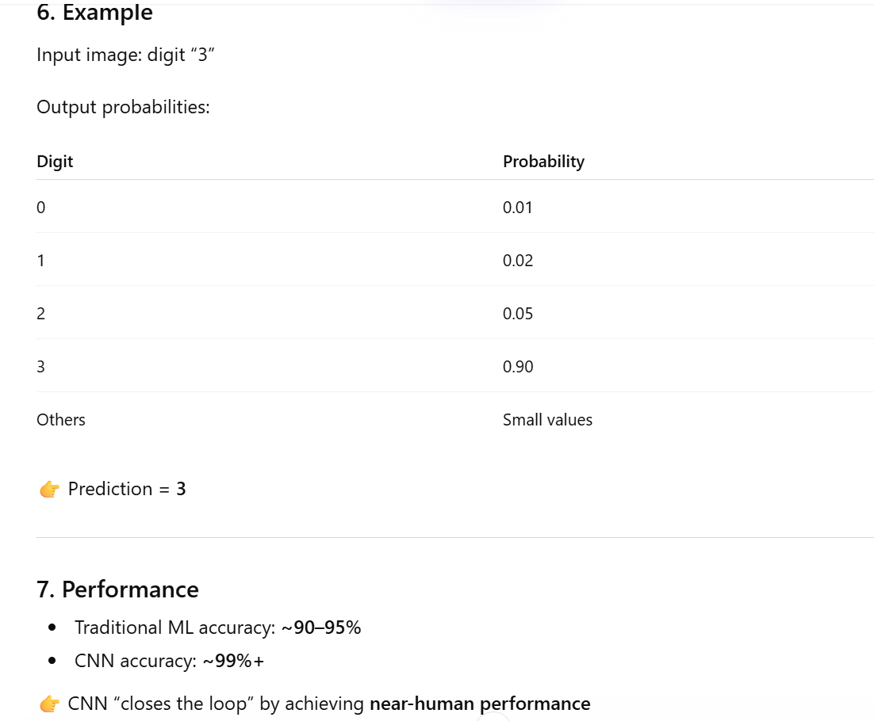

Slide 61
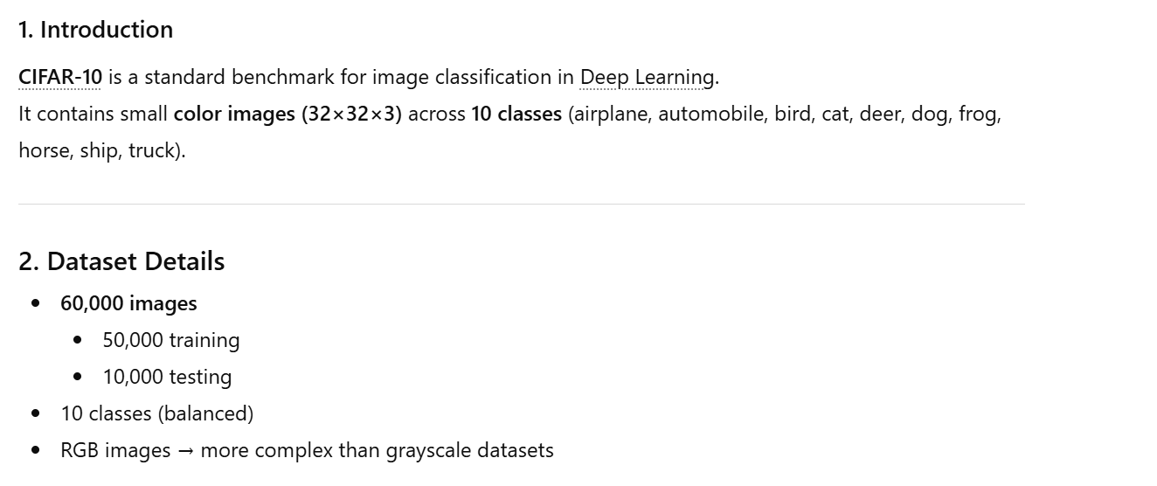
7. Building a Convolutional Network for CIFAR-10

Slide 62
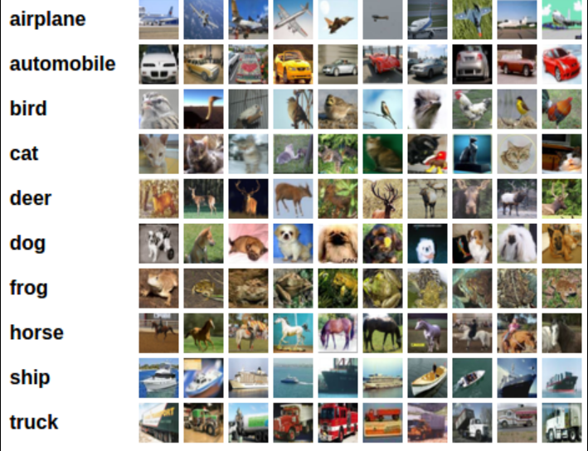

Slide 63


Slide 64


Slide 65


Slide 66


Slide 67


Slide 68
8. Visualizing Learning in Convolutional Networks
1. Introduction
Visualizing learning in CNNs means understanding what a Convolutional Neural Network learns internally while processing images. Since CNNs are often called “black-box models,” visualization helps interpret their behavior in Deep Learning.

Slide 69


Slide 70


Slide 71


Slide 72



Slide 73

9. Leveraging Convolutional Filters to Replicate Artistic Styles

Slide 74


Slide 75


Slide 76
1. Introduction
Leveraging convolutional filters to replicate artistic styles refers to using Convolutional Neural Networks (CNNs) to transform an image so that it preserves its content but adopts the artistic style of another image. This technique is popularly known as Neural Style Transfer (NST) in Deep Learning.
2. Basic Idea
We combine:
Content Image → structure (objects, shapes)
Style Image → texture, colors, brush strokes
Output = Stylized Image.

Slide 77
3. Role of Convolutional Filters
CNN filters extract different types of information:
Content Representation
Extracted from deeper layers
Captures:
Shapes
Object structure
Style Representation
Extracted from multiple layers
Captures:
Textures
Patterns
Colors
Style is represented using Gram Matrix (correlation between feature maps)

Slide 78

4. Working of Neural Style Transfer(NST)
Step 1: Input Images
Content image (e.g., a photo)
Style image (e.g., painting)
Step 2: Pass through CNN
Use a pretrained network (like VGG)
Step 3: Extract Features
Content features from deeper layers
Style features from multiple layers
Step 4: Compute Loss
Content Loss
Difference between content features
Style Loss
Difference between Gram matrices
Total Loss
$$\text{Total} \text{Loss}=\text{Content} \text{Loss}+\text{Style} \text{Loss}$$
Step 5: Optimization
Start with random or content image .
Update pixels using gradient descent .
Minimize total loss .

Slide 79
5. Example
Content image: Person photo .
Output:
Same person image.
With swirling brush strokes and colors of the painting.
6. Key Concepts
1. Feature Maps
Represent extracted patterns.
2. Gram Matrix
Captures style (texture relationships).
3. Pretrained Networks
Commonly used VGG-19.

Slide 80
7. Advantages
1. Produces visually appealing results .
2. Demonstrates the power of CNN feature extraction.
3. No need for labeled data.
8. Limitations
1. Computationally expensive.
2. May distort content if not balanced properly
3. Requires tuning of loss weights.
9. Applications
1. Digital art creation.
2. Photo editing apps.
3. Film and animation.

Slide 81
10. Learning Convolutional Filters for Other Problem Domains
1. Definition
Convolutional filters are the core components of Convolutional Neural Networks (CNNs). Although originally designed for image processing, these filters can be extended to other domains to learn patterns from data automatically. This capability makes CNNs highly powerful in Deep Learning.
2. Concept of Convolutional Filters
A convolutional filter (kernel) is a small matrix that moves across input data and performs:
Element-wise multiplication
Summation
The result is a feature map that highlights important patterns such as edges, trends, or correlations.

Slide 82
3. Generalization of Convolution Across Domains
Convolution is not limited to images. It can be applied to different data structures:
(1)1D Convolution
Used for sequential data
Input: 1D signals
Applications:
Time-series (stock prices, weather data)
Audio processing
Text analysis
Learns temporal patterns and trends.

Slide 83
(2) 2D Convolution
Used for image data
Input: 2D matrix (height × width)
Applications:
Image classification
Object detection
(3) 3D Convolution
Used for volumetric or temporal data
Applications:
Video processing (frame sequences)
Medical imaging (MRI, CT scans)

Slide 84
4. Applications in Various Domains
Natural Language Processing (NLP).
Speech Recognition.
Time-Series Analysis.
Healthcare and Medical Field.
Video and Multimedia Processing.

Slide 85
5. Working Mechanism
Input data (text, audio, image, etc.)
Apply convolution filters
Generate feature maps
Apply activation function (ReLU)
Pooling reduces dimensions
Fully connected layer for classification

Slide 86
6. Advantages
Automatic feature extraction
Reduces manual effort
Works across multiple domains
Captures local dependencies effectively
High accuracy in complex tasks
7. Challenges
Requires large datasets
Computationally expensive
Complex model tuning
Difficult to interpret

Slide 87
11. Training algorithms.
1. Introduction
Training algorithms are methods used to train neural networks by adjusting weights and biases to minimize error. They play a crucial role in learning patterns from data in Deep Learning.
2. Objective of Training
The main goal is to:
Minimize the loss (error) function .
Improve model accuracy.
Learn optimal parameters.

Slide 88
3. Steps in Training a Neural Network
Step 1: Forward Propagation
Input data is passed through the network
Output is generated
Step 2: Loss Calculation
Compare predicted output with actual output
Compute error using loss functions
Examples:
Mean Squared Error (MSE)
Cross-Entropy Loss
Step 3: Backpropagation
Error is propagated backward
Gradients are calculated using chain rule
Step 4: Weight Update
Weights are updated using optimization algorithms

Slide 89

4. Gradient Descent Algorithm
Definition
An optimization algorithm used to minimize the loss function.
Formula
$W=W−η\frac{dL}{dW}$
Where:
$W$= weights
$η$= learning rate
$L$= loss function

Slide 90
5. Types of Gradient Descent:- 3 Types
1. Batch Gradient Descent
Uses entire dataset
Accurate but slow
2. Stochastic Gradient Descent (SGD)
Uses one data point at a time
Faster but noisy
3. Mini-Batch Gradient Descent
Uses small batches
Balance between speed and accuracy

Slide 91
6. Techniques to Improve Training
Regularization (Dropout, L2)
Batch Normalization
Learning rate scheduling
Data augmentation
7. Applications
Training algorithms are used in:
Image classification
Speech recognition
Natural language processing
Medical diagnosis

